Slide 1
Models in django
Django mastery course in Nepali

Slide 2
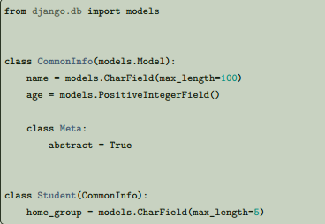
Model inheritance Model inheritance in Django works almost identically to the way normal class inheritance works in Python, but the basics at the beginning of the page should still be followed. That means the base class should subclass django.db.models.Model. The only decision you have to make is whether you want the parent models to be models in their own right (with their own database tables), or if the parents are just holders of common information that will only be visible through the child models. There are three styles of inheritance that are possible in Django. 1. Often, you will just want to use the parent class to hold information that you don’t want to have to type out for each child model. This class isn’t going to ever be used in isolation, so Abstract base classes are what you’re after. 2. If you’re subclassing an existing model (perhaps something from another application entirely) and want each model to have its own database table, Multi-table inheritance is the way to go. 3. Finally, if you only want to modify the Python-level behavior of a model, without changing the models fields in any way, you can use Proxy models.
Abstract base classes
Abstract base classes are useful when you want to put some common information into a number of other models. You write your base class and put abstract=True in the Meta class. This model will then not be
used to create any database table. Instead, when it is used as a base class for other models, its fields will be added to those of the child class.
Fields inherited from abstract base classes can be overridden with another field or value, or be removed with
None.

Slide 3
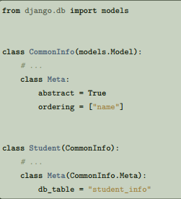
Meta inheritance When an abstract base class is created, Django makes any Meta inner class you declared in the base class available as an attribute. If a child class does not declare its own Meta class, it will inherit the parent’s Meta. If the child wants to extend the parent’s Meta class, it can subclass it. For example:

Slide 4

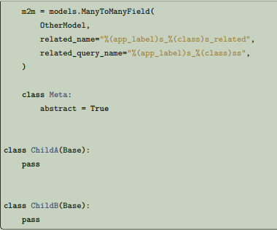
Be careful with related_name and related_query_name If you are using related_name or related_query_name on a ForeignKey or ManyToManyField, you must always specify a unique reverse name and query name for the field. This would normally cause a problem in abstract base classes, since the fields on this class are included into each of the child classes, with exactly the same values for the attributes (including related_name and related_query_name) each time. To work around this problem, when you are using related_name or related_query_name in an abstract base class (only), part of the value should contain '%(app_label)s' and '%(class)s'. • '%(class)s' is replaced by the lowercased name of the child class that the field is used in. • '%(app_label)s' is replaced by the lowercased name of the app the child class is contained within. Each installed application name must be unique and the model class names within each app must also be unique, therefore the resulting name will end up being different.

Slide 5
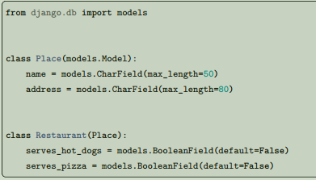

The reverse name of the common.ChildA.m2m field will be common_childa_related and the reverse query name will be common_childas. The reverse name of the common.ChildB.m2m field will be common_childb_related and the reverse query name will be common_childbs. Finally, the reverse name of the rare.ChildB.m2m field will be rare_childb_related and the reverse query name will be rare_childbs. It’s up to you how you use the '%(class)s' and '%(app_label)s' portion to construct your related name related query name but if you forget to use it, Django will raise errors when you perform system checks (or run migrate). If you don’t specify a related_name attribute for a field in an abstract base class, the default reverse name will be the name of the child class followed by '_set', just as it normally would be if you’d declared the field directly on the child class. For example, in the above code, if the related_name attribute was omitted, the reverse name for the m2m field would be childa_set in the ChildA case and childb_set for the ChildB field.
Multi-table inheritance The second type of model inheritance supported by Django is when each model in the hierarchy is a model all by itself. Each model corresponds to its own database table and can be queried and created individually. The inheritance relationship introduces links between the child model and each of its parents (via an automatically-created OneToOneField). For example:
All the fields of Place will also be available in Restaurant, although the data will reside in a different database table. So, these are both possible:

Slide 6

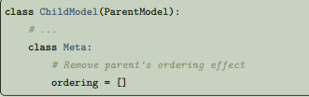
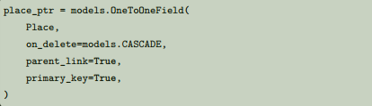
If you have a Place that is also a Restaurant, you can get from the Place object to the Restaurant object by using the lowercase version of the model's name:
Meta and multi-table inheritance
In the multi-table inheritance situation, it doesn’t make sense for a child class to inherit from its parent’s Meta class. All the Meta options have already been applied to the parent class and applying them again would normally only lead to contradictory behavior (this is in contrast with the abstract base class case, where the base class doesn’t exist in its own right). So a child model does not have access to its parent’s Meta class. However, there are a few limited cases
where the child inherits behavior from the parent: if the child does not specify an ordering attribute or a get_latest_by attribute, it will inherit these from its parent. If the parent has an ordering and you don’t want the child to have any natural ordering, you can explicitly disable it:
However, if p in the above example was not a Restaurant (it had been created directly as a Place object or was the parent of some other class), referring to p.restaurant would raise a Restaurant.DoesNotExist exception. The automatically-created OneToOneField on Restaurant that links it to Place looks like this:

Slide 7
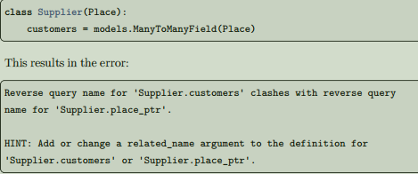
Inheritance and reverse relations
Because multi-table inheritance uses an implicit OneToOneField to link the child and the parent, it’s possible to move from the parent down to the child, as in the above example. However, this uses up the name that is the default related_name value for ForeignKey and ManyToManyField relations. If you are putting those types of relations on a subclass of the parent model, you must specify the related_name attribute on each such field. If you forget, Django will raise a validation error. For example, using the above Place class again, let’s create another subclass with a ManyToManyField:
Specifying the parent link field
As mentioned, Django will automatically create a OneToOneField linking your child class back to any nonabstract parent models. If you want to control the name of the attribute linking back to the parent, you can create your own OneToOneField and set parent_link=True to indicate that your field is the link back to the
parent class.
Adding related_name to the customers field as follows would resolve the error: models. ManyToManyField(Place, related_name='provider').

Slide 8
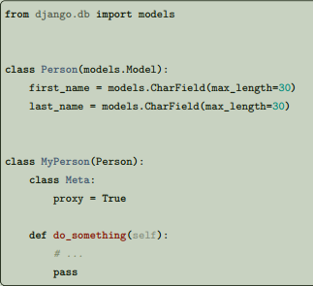
Proxy models
When using multi-table inheritance, a new database table is created for each subclass of a model. This is usually the desired behavior, since the subclass needs a place to store any additional data fields that are not present on the base class. Sometimes, however, you only want to change the Python behavior of a model –perhaps to change the default manager or add a new method. This is what proxy model inheritance is for: creating a proxy for the original model. You can create, delete and update instances of the proxy model and all the data will be saved as if you were using the original (non-proxied) model. The difference is that you can change things like the default model ordering or the default
manager in the proxy, without having to alter the original. Proxy models are declared like normal models. You tell Django that it’s a proxy model by setting the proxy attribute of the Meta class to True. For example, suppose you want to add a method to the Person model. You can do it like this:

Slide 9

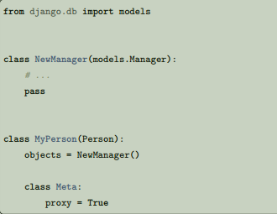

The MyPerson class operates on the same database table as its parent Person class. Any new instances of Person will also be accessible through MyPerson, and vice-versa:
Base class restrictions
A proxy model must inherit from exactly one non-abstract model class. You can’t inherit from multiple non-abstract models as the proxy model doesn’t provide any connection between the rows in the different database tables. A proxy model can inherit from any number of abstract model classes, providing they do not define any model fields. A proxy model may also inherit from any number of proxy models that share a common non-abstract parent class.
Proxy model managers
If you don’t specify any model managers on a proxy model, it inherits the managers from its model parents. If you define a manager on the proxy model, it will become the default, although any managers defined on the parent classes will still be available. Continuing our example from above, you could change the default manager used when you query the Person model like this
You could also use a proxy model to define a different default ordering on a model. You might not always want to order the Person model, but regularly order by the last_name attribute when you use the proxy:

Slide 10
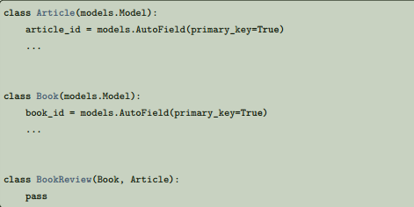
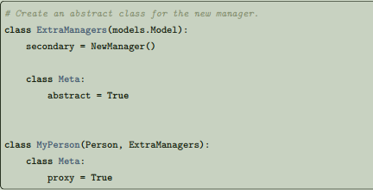
Multiple inheritance
Just as with Python’s subclassing, it’s possible for a Django model to inherit from multiple parent models. Keep in mind that normal Python name resolution rules apply. The first base class that a particular name (e.g. Meta) appears in will be the one that is used; for example, this means that if multiple parents contain a Meta class, only the first one is going to be used, and all others will be ignored. Generally, you won’t need to inherit from multiple parents. The main use-case where this is useful is for “mixin” classes: adding a particular extra field or method to every class that inherits the mix-in. Try to keep your inheritance hierarchies as simple and straightforward as possible so that you won’t have to struggle to work out where a particular piece of information is coming from. Note that inheriting from multiple models that have a common id primary key field will raise an error. To properly use multiple inheritance, you can use an explicit AutoField in the base models:
If you wanted to add a new manager to the Proxy, without replacing the existing default, you can use the techniques described in the custom manager documentation: create a base class containing the new managers and inherit that after the primary base class:

Slide 11
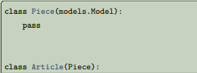
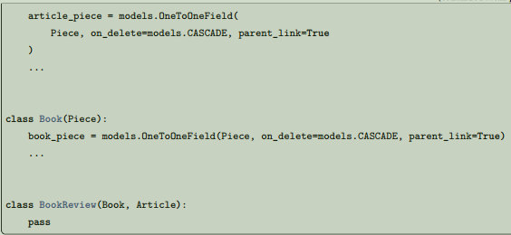
Or use a common ancestor to hold the AutoField. This requires using an explicit OneToOneField from each parent model to the common ancestor to avoid a clash between the fields that are automatically generated and inherited by the child:

Slide 12
Thank you for watching
💖

